Slide 1

Tech-Career recruiting site
Group b – recruiter registration && Job offers

Slide 2
Agenda
Product Overview
First characterization – UI/UX
Technologies
Our team and pages
Collaboration
Challenges
GitHub
Go to Market
What’s next?

Slide 3
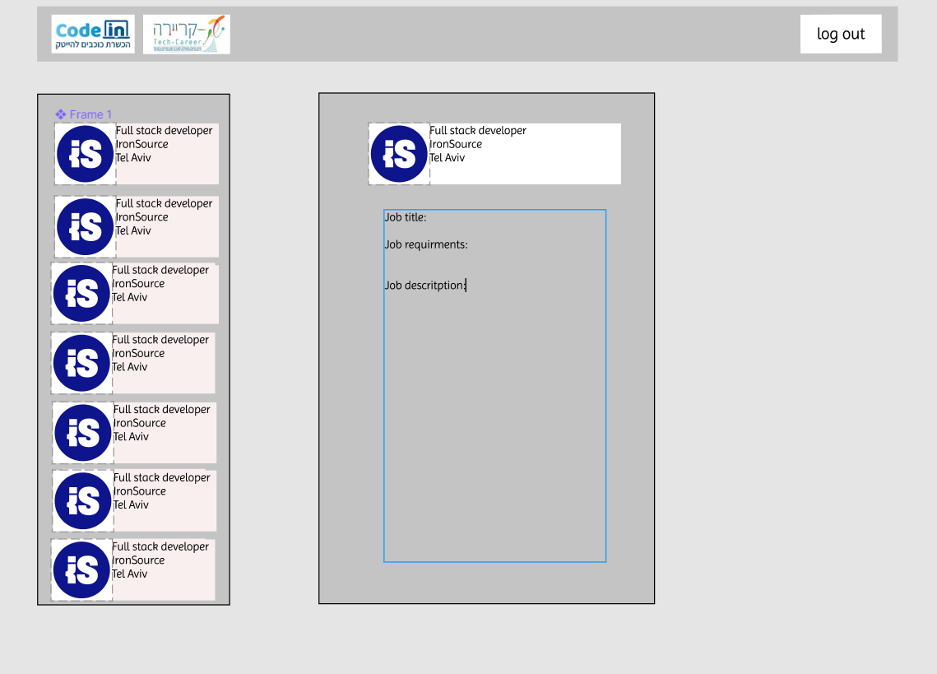
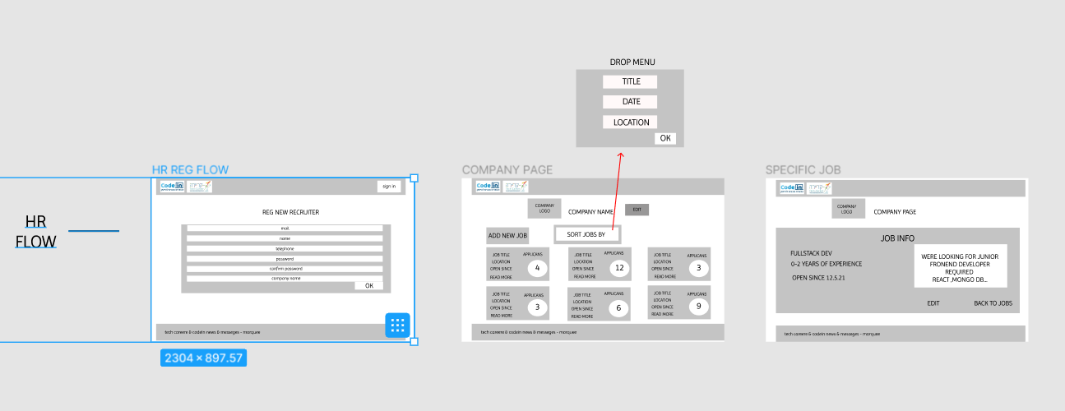
Product Overview
Working with Figma
Choosing the right technologies
Getting started

Slide 4
Product Overview
Company-Zone
User data by redux
Recruiter-Register
EdgeCases
Job-Offers
Sync Across Devices
Include Images
History/push
Craete new job
UseParams
Disposable Link
using Db
Back-end
Creating DB
Create front service

Slide 5
Collaboration
Main Challenges
GitHub
Synchronizing t o other pages/branches

Slide 6

What’s next
“It’s not done when it works. It’s Done when it’s RIGHT.”
- Robert C. Martin

Slide 7
Thank you!
ANY QUESTIONS?

